Slide 1






Approximation, Probability, and Optimization
Dr. Animesh Chaturvedi
Assistant Professor: IIIT Dharwad
Young Researcher: Heidelberg Laureate Forum
and Pingala Interaction in Computing
Young Scientist: Lindau Nobel Laureate Meetings
Postdoc: King’s College London & The Alan Turing Institute
PhD: IIT Indore MTech: IIITDM Jabalpur

Slide 2
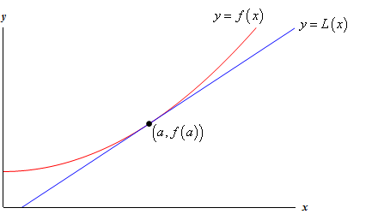
Approximation
Efficient algorithms that find approximate solutions to NP optimization problems.
Solution with provable guarantees such that the solution is near-exact solution.
A tangent to a curve is a straight line that best approximates the curve at a specific point.
Linear approximation for the curve near the point of tangency. For a value of x very close to x₀, the function's value f(x) can be approximated by the value on the tangent line at a point (x₀,y₀) is given by y - y₀ = m(x - x₀) ➔ f(x) ≈ f(x₀) + f’(x₀)(x-x₀).
Example:
Vertex Cover Problem,
Traveling Salesman Problem,
Set-covering problem (resource-selection problems)
Subset-sum problem
https://en.wikipedia.org/wiki/Approximation_algorithm

Slide 3
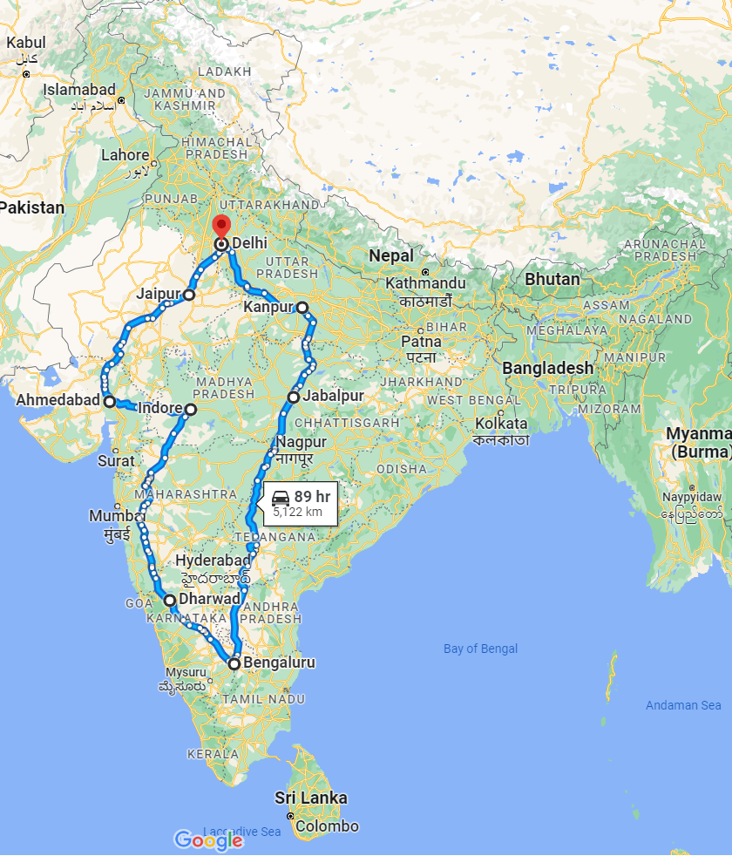
Approximation
Karp (1972) proved the TSP to be NP-hard, but effective heuristic approximation methods were developed (Lin and Kernighan, 1973).
The traveling-salesperson problem (TSP) is a standard combinatorial problem in theoretical computer science (Lawler et al., 1992).
Arora (1998) devised a fully polynomial approximation scheme for Euclidean TSPs.
Cormen, T. H., Leiserson, C. E., Rivest, R. L., & Stein, C. (2009). Introduction to Algorithms (Vol. 3, pp. 624-642). Cambridge: MIT press.
Stuart Russel, and Peter Norvig. "Artificial intelligence: A modern approach. Third edit." Upper Saddle River, New Jersey 7458 (2015). http://aima.cs.berkeley.edu/

Slide 4

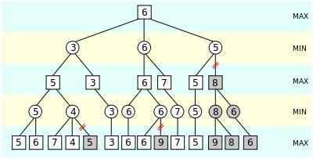
Approximation
VLSI layout methods are surveyed by Shahookar and Mazumder (1991), and many layout optimization papers appear in VLSI journals.
Approximation in Mini-Max is to cut the search off at some point
Cormen, T. H., Leiserson, C. E., Rivest, R. L., & Stein, C. (2009). Introduction to Algorithms (Vol. 3, pp. 624-642). Cambridge: MIT press.
Stuart Russel, and Peter Norvig. "Artificial intelligence: A modern approach. Third edit." Upper Saddle River, New Jersey 7458 (2015). http://aima.cs.berkeley.edu/

Slide 5
AI with Approximation
Used when NP-Hard problems are difficult to solve exactly
Approximation provides near-optimal solutions efficiently
When a problem is NP-Complete or NP-Hard, exact polynomial-time solutions likely don’t exist. So, Approximation becomes important.
Examples:
Traveling Salesman Problem (TSP) → NP-Hard ✓ Polynomial approximation with guarantees
Vertex Cover → NP-Complete ✓ 2-approximation algorithm exists
Knapsack → NP-Complete ✓ Fully Polynomial Time Approximation Scheme (FPTAS)
Approximation is a way to handle NP-Hard problems efficiently, trading accuracy for speed.

Slide 6
Probability and AI

Slide 7
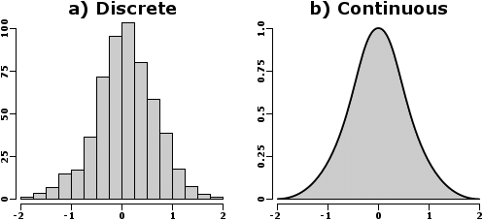
Probabilistic Vs Stochastic
Deterministic system are predictable.
The state of the system can be forecasted for given input, constraints, and mathematical model.
States of a deterministic system are pre-determined.
Non-Deterministic system are unpredictable
Stochastic and Probabilistic are usually used interchangeably.
Both represent the randomness present in the system.
Probabilistic is superset concept of stochastic.

Slide 8


Probabilistic Vs Stochastic
Probabilistic models are independent of time,
which describes system with numerical chances or likelihood of an event to occur.
E.g., Lottery numbers are independent of each other.
Each instance is determined by the same probability distributions, but with no memory of older instance.
Stochastic models are time dependent systems,
whose changes are described by its past and probabilities for successive changes.
E.g., Price of a stock is its old price and an uncertain change.
The uncertainty are small, which is semi-predictable.
If the stock was closed at 100,
then its opening value is predictable around 90 or 110.
https://qr.ae/pvU18E
https://qr.ae/pvU11n

Slide 9
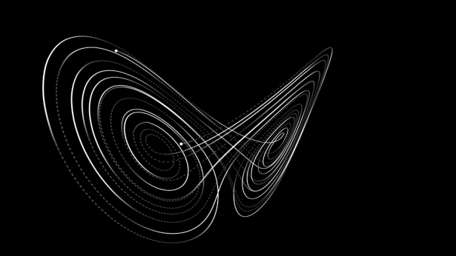
Stochastic and Chaotic
A chaotic system is deterministic in theory.
It responds drastically to infinitesimal changes in initial and boundary conditions, making it in practice unpredictable and unstable.
Deterministic chaos, or simply Chaos.
Chaos: “When the present determines the future, but the approximate present does not approximately determine the future.”
A stochastic system is a random phenomenon.
Stochastic and Chaotic two terms interchangeably.
It is hard to distinguish between chaotic and stochastic systems.
Random
Deterministic
Unpredictable
Stochastic
Chaotic
https://en.wikipedia.org/wiki/Chaos_theory
https://qr.ae/pvU11A

Slide 10
AI with Probability
Randomized algorithms handle NP-hardness
Randomization helps solve hard problems faster on average, even if worst-case is NP-Hard.
Examples:
Randomized SAT solvers (WalkSAT) → Practical AI search
Monte Carlo Tree Search → Used in reinforcement learning (e.g., AlphaGo)
Probabilistic Graphical Model Inference → NP-Hard, solved via sampling
Some NP problems become tractable on average using randomness.
Probability softens NP-hardness in practice, especially in AI.

Slide 11
Optimization and AI

Slide 12
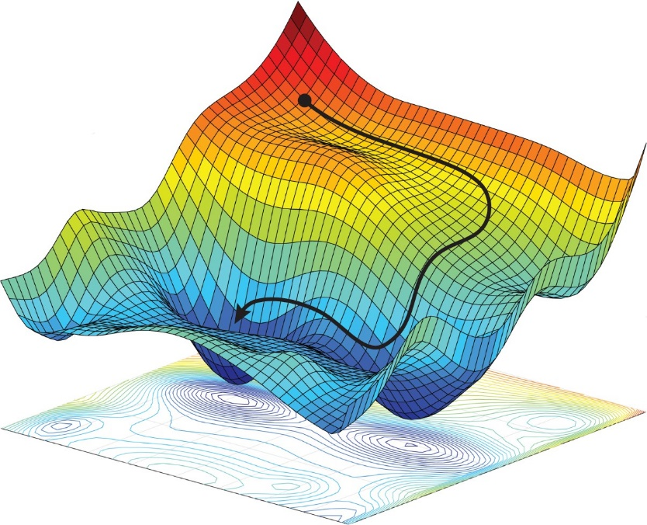
Optimization
An optimization problem can be represented in the following way:
Given: a function f : A → ℝ from some set A to the real numbers
Goal: an element x₀ ∈ A such that f(x₀) ≤ f(x) for all x ∈ A ("minimization") or such that f(x₀) ≥ f(x) for all x ∈ A ("maximization").
The domain A of f is called the search space or the choice set
The elements of A are called candidate solutions or feasible solutions.
A is some subset of the
Euclidean space ℝ^{n}, Geometry represent N-dimensional space
Specified by a set of constraints,
Equalities or inequalities that the members of A have to satisfy
https://en.wikipedia.org/wiki/Mathematical_optimization

Slide 13
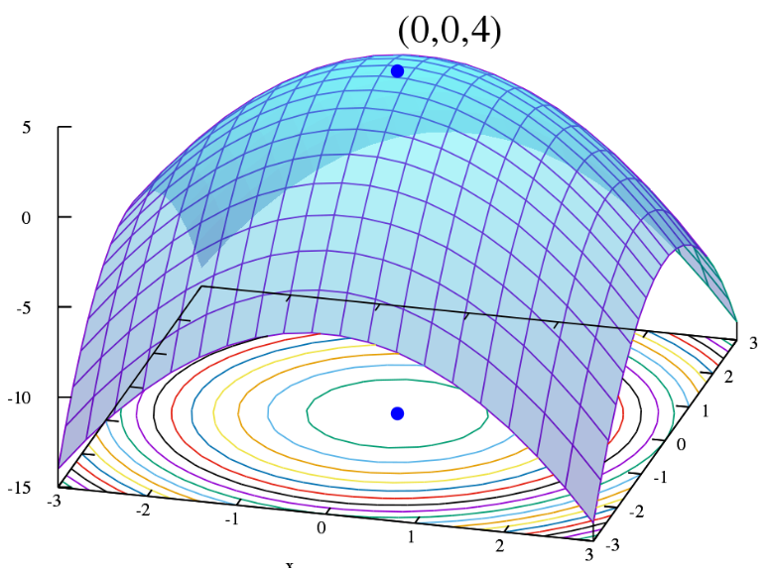
Optimization
Problem of finding the best solution from all feasible solutions.
Discrete optimization: A problem with discrete variables in which an object must be found from a countable set like integer, permutation or graph
Combinatorial optimization
Continuous optimization: A problem with continuous variables in which an optimal value from a continuous function must be found.
Constrained problems
Multimodal problems
https://en.wikipedia.org/wiki/Optimization_problem

Slide 14
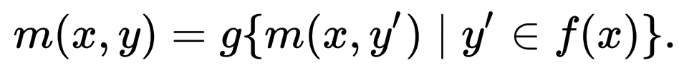
Combinatorial optimization
Finds an optimal object from a finite set of objects, where the set of feasible solutions is discrete or can be reduced to a discrete set.
Exhaustive search uses algorithms that quickly rule out large parts of the search space,
Or use Approximation or Probabilistic algorithms.
A combinatorial optimization problem A is a quadruple (I, f, m, g), where
I is a set of instances; given an instance x ∈ I, f(x) is the set of feasible solutions;
Given an instance x and a feasible solution y of x, m(x, y) denotes the measure of y, which is usually a positive real.
g is the goal function, and is either min or max.
Goal is to find for some instance x an optimal solution, that is, a feasible solution of y
https://en.wikipedia.org/wiki/Combinatorial_optimization

Slide 15
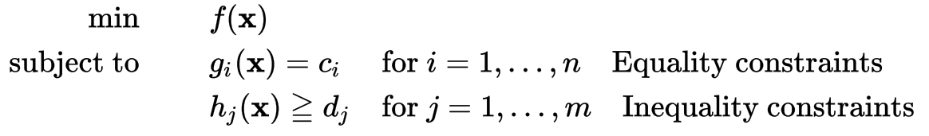
Constrained optimization
Process of optimizing an objective function with respect to some variables in the presence of constraints on those variables.
primarily equality constraints, inequality constraints, and integer constraints
set of candidate solutions that satisfy all constraints is called the feasible set
A general constrained minimization problem may be written as follows:
where g_{i}(x) and h_{j}(x) are constraints that are required to be satisfied, and f(x) is the objective function that needs to be optimized subject to the constraints
https://en.wikipedia.org/wiki/Constrained_optimization

Slide 16
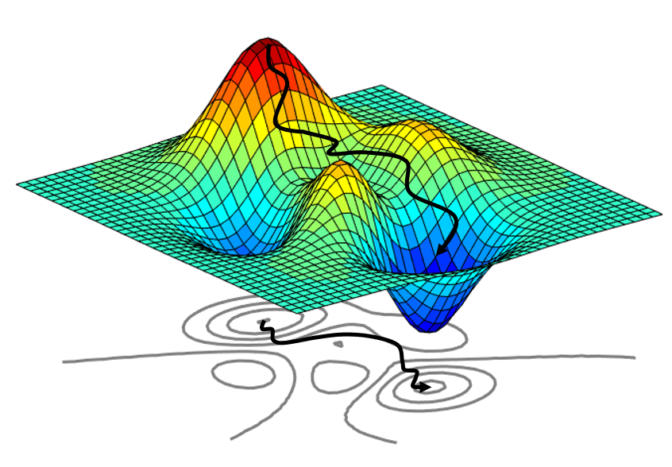
Multimodal optimization
Finds all or most of the multiple (at least locally optimal) solutions of a problem, as opposed to a single best solution.
Evolutionary Multimodal Optimization is a branch of Evolutionary Computation
Evolutionary algorithms:
Genetic Algorithms (GAs),
Evolution Strategy (ES),
Differential Evolution (DE),
Particle Swarm Optimization (PSO) etc.
https://en.wikipedia.org/wiki/Evolutionary_multimodal_optimization

Slide 17
AI with Optimization
Many Optimization problems are NP-Hard, Examples:
Maximum Clique → NP-Complete
Set Cover → NP-Complete
Max-Cut → NP-Hard
Integer Programming → NP-Hard
Optimization appears everywhere:
Operations research
Machine learning (training a model = optimization)
Robotics path planning
Many real-world optimization problems are NP-Hard, which forces us to use: ✔ heuristics, ✔ greedy strategies ✔ meta-heuristics (GA, PSO, Simulated Annealing) ✔ relaxations (LP/SDP)

Slide 18
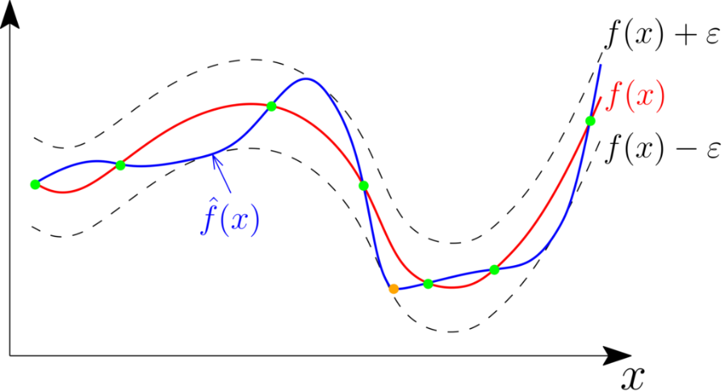
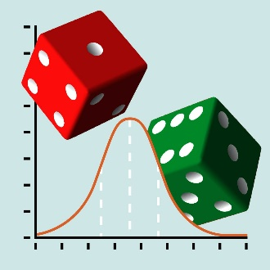
Approximation, Probability, and Optimization
Deterministic nature of a system does not make it predictable.
Exhaustive search is intractable for NP-hard problems
Used Approximations, Probabilistic, and Optimization algorithms in
Travelling Salesman Problem (TSP), Minimum Spanning Tree (MST), and Knapsack
Minimax, Alpha–Beta pruning,
Monte Carlo, Markov chain Monte Carlo,
Constraint Satisfaction Problems,
Likelihood weighting, Maximum-Likelihood,
Stochastic Differential Equations (SDEs),
Belief states, Belief propagation, Bayesian Networks, Deep Belief Networks,
Various Machine Learning, Deep Learning, Reinforcement Learning algorithms,
and several other problems
https://mattiheino.com/2016/12/27/deterministic-not-predictable/

Slide 19
AI with Approximation, Probability, Optimization
Approximation: Near-optimal polynomial-time
Probability: Randomization helps average case
Optimization: Relaxations, metaheuristics
AI: Heuristics, search, etc.
Field | Why NP matters here | Techniques used
Approximation | Exact solutions impossible in P | Guaranteed near-optimal algorithms
Probability | Randomized solutions beat worst-case | Monte Carlo, stochastic search
Optimization | Most optimization ≈ NP-hard | Relaxation, metaheuristics
AI | Search, reasoning, learning tasks | Heuristics, pruning, knowledge base

Slide 20
P and NP
What is P?
Problems solvable efficiently (polynomial time) using deterministic algorithms
Example: Sorting numbers
What is NP?
Solutions can be verified efficiently, but finding the solution is in-efficient
Example: Verifying TSP route length
P vs NP:
Can every problem whose solution is easy to check also be solved quickly?
Unknown whether P = NP
Believed P ≠ NP, but unproven

Slide 21
AI's Historical Approach to Complex Problems
Approximation Algorithms:
Guarantee bounds near optimal
Algorithms for NP-complete problems provide a solution that is guaranteed to be within a certain factor of the optimal answer for real-world applications.
Rule-based AI:
Hand-coded rules struggled with combinatorial exponential growth
Example: Chess search
Heuristics and Approximations:
Provided near-optimal solutions or “calculated guesses”, to NP-hard problems
Example: Heuristic search algorithms to find a near-optimal route for the TSP instead of exhaustively checking all routes

Slide 22
How Modern AI Tackles NP-Hard Problems
Machine Learning and Optimization:
Modern AI, Rather than finding the exact solution, AI finds optimal solution.
Techniques like Neural Networks learn near-optimal solutions to NP-hard problems.
Reinforcement Learning (RL):
Learns strategies for complex domains (e.g., Go)
RL agents can be trained to solve complex problems like playing chess or Go by exploring a huge number of potential moves, eventually learning optimal strategies.
RL is a practical solution to problems that were previously intractable.

Slide 23
Artificial Neural Networks & Complexity
Training neural networks = Optimization problem (NP-Hard)
Inference depends on probability (stochastic models)
Universal Approximation Theorem → Approximation category
Artificial Neural Networks has the intersection of
Optimization + Probability + Approximation

Slide 24
Future Intersection of AI
Quantum Computing + AI:
Computational power to tackle NP problems that are hard with classical computers.
AI for Scientific Discovery: To model and predict complex systems in sciences.
Example: Progress on protein folding and simulations.
This could lead to breakthroughs in solving NP-hard problems.
Explainable AI: Transparency helps guide complexity reasoning
Understanding why a model makes a certain decision "the black box problem".
Interactive AI that focuses on making AI more transparent on complex problems.

Slide 25
Summary
P → Efficient & deterministic → “Easy problems”
NP → Solutions easy to verify → Many search/decision problems in AI
NP-Complete → Hardest in NP → Guide complexity barriers
NP-Hard → At least as hard as NP → Optimization & AI problems
In practice, NP-Hardness drives research in:
Heuristics → AI
Approximation → Algorithms
Randomization → Probability
Relaxations → Optimization
Artificial Neural Networks → Optimization + Approximation + Probability

Slide 26
References
Cormen, T. H., Leiserson, C. E., Rivest, R. L., & Stein, C. (2009). Introduction to Algorithms (Vol. 3, pp. 624-642). Cambridge: MIT press.
Stuart Russel, and Peter Norvig. "Artificial intelligence: A modern approach. Third edit." Upper Saddle River, New Jersey 7458 (2015). http://aima.cs.berkeley.edu/
Wikipedia pages https://www.wikipedia.org/
Images are from several sources e.g. movies, TV serials, internet, miscellaneous links, slides, blogs, etc.
Quora
https://qr.ae/pvU18E
https://qr.ae/pvU11n
https://en.wikipedia.org/wiki/Chaos_theory
https://qr.ae/pvU11A

Slide 27
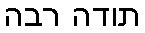
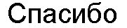
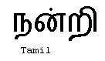
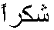
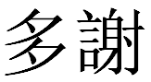
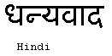
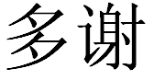
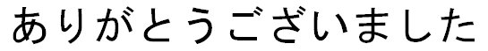
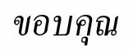
Ευχαριστώ
Hebrew
Greek
Danke
Russian
German
धन्यवादः
Merci
ধন্যবাদ
Sanskrit
Bangla
Thank You
Tamil
Arabic
French
ಧನ್ಯವಾದಗಳು
നന്ദി
Kannada
Malayalam
Grazie
English
ధన్యవాదాలు
આભાર
Traditional Chinese
Italian
Telugu
Gujarati
ਧੰਨਵਾਦ
Gracias
Punjabi
Hindi & Marathi
Spanish
Simplified Chinese
https://sites.google.com/site/animeshchaturvedi07
Obrigado
Portuguese
Japanese
Thai
Korean

